Slide 1

BrainGB: A Benchmark for Brain Network Analysis with Graph Neural Networks
Hejie Cui¹, Wei Dai¹, Yanqiao Zhu², Xuan Kan¹, Antonio Chen¹, Joshua Lukemire³, Liang Zhan⁴, Lifang He⁵, Ying Guo³, Carl Yang^{1†}
Presented by :
Deepa Tilwani
PhD Student
AI Institute, University of South Carolina

Slide 2
Why BrainGB?
No proper standard techniques/framework available for the brain network analysis.
Designed to enable fair evaluation with accessible datasets.
Standardize settings, and baselines for collaborative environment within computational neuroscience research

Slide 3
Outline
Preliminaries
Brain Network Dataset Construction
GNN Baselines for Brain Network Analysis
Experiments
Discussion and Extensions
3

Slide 4
Outline
Preliminaries
Brain Network Dataset Construction
GNN Baselines for Brain Network Analysis
Experiments
Discussion and Extensions
4

Slide 5
Brain Networks
Human brain are at the center of neurobiological systems.
The interactions between brain regions are key driving factors for disorder analysis.
Brain network: composed by nodes representing brain regions and edges representing interactions between them.
September 14, 2022
BrainGB: A Benchmark for Brain Network Analysis with Graph Neural Networks
4

Slide 6
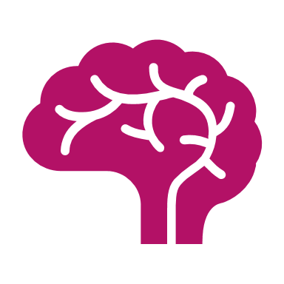
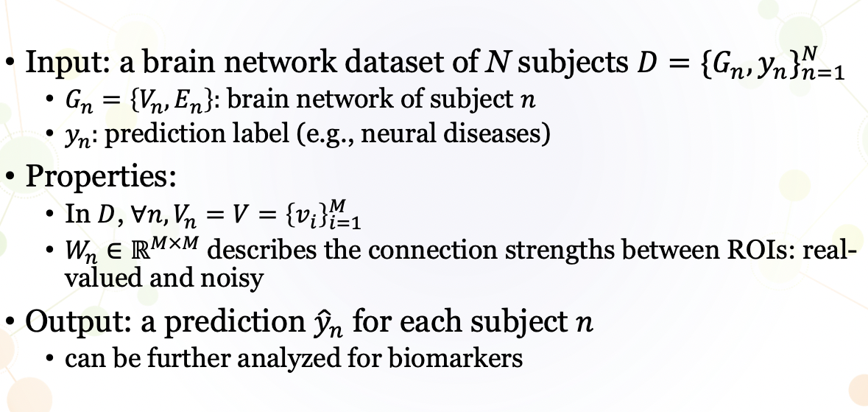
Brain Network Analysis
--> ROI* |
E_{n}: Difference across subjects (edges)₋
*ROI : Region of Interest

Slide 7
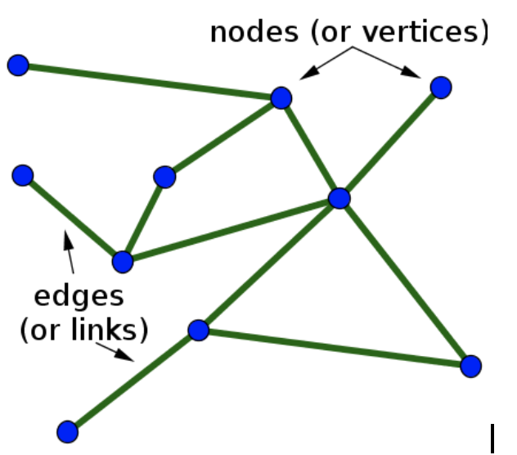
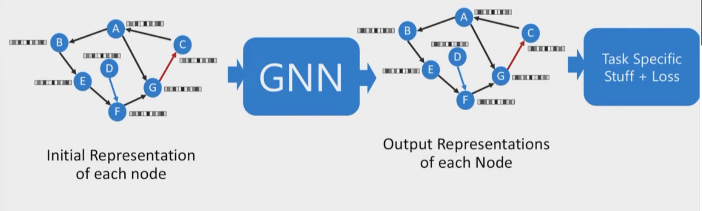

Graph Neural Networks (GNN)
v
e
Goal: GNN are efficient feature learning for machine learning on graphs
Low-dimensional node embeddings encode both structural and attributive information

Slide 8
The Uniqueness of Brain Networks
Lack of initial node (ROI) features
Real-valued functional connection weights can be both + or –
ROI identities and the orders of these regions across individual graphs are fixed.
The design of GNN models for brain network should be customized to fit its unique nature

Slide 9
Challenges
Brain
Brain network construction
Restricted data accessibility
Sophisticated brain imaging preprocessing and network construction processes that differ across modalities
Analyze
Analyze the resulting brain connectivity
Build an assessment pipeline that is consistent and is based on metrics, baselines that are standardized designed, and can be reasonable for experimental conditions.

Slide 10
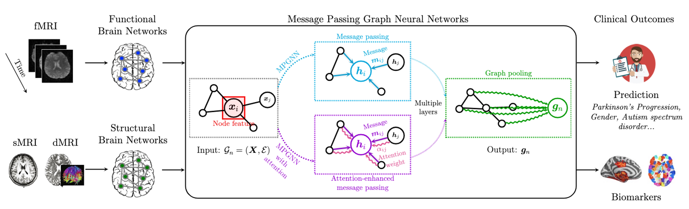
Overview
Fig. 1. Overview of BrainGB framework for brain network analysis with graph neural networks.
Image Src : BrainGB: A Benchmark for Brain Network Analysis with Graph Neural Networks

Slide 11
Outline
Preliminaries
Brain Network Dataset Construction
GNN Baselines for Brain Network Analysis
Experiments
Discussion and Extensions

Slide 12
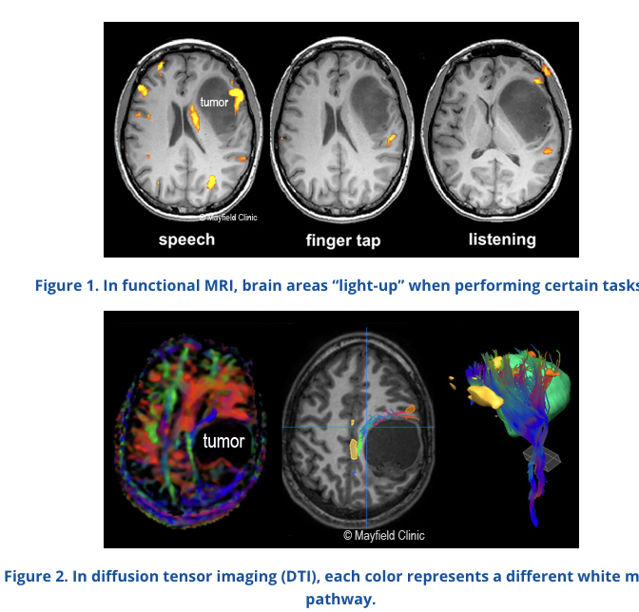
Neuroimaging Acquisition
Various medical imaging techniques: MRI, EEG, PET, etc.
Magnetic-Resonance Imaging (MRI) are the most widely used for brain analysis research.
Function MRI (fMRI)
functional brain networks
The goal of fMRI data analysis is to detect correlations between brain activation and a task the subject performs during the scan
Diffusion Tensor Imaging (DTI)
structural brain networks
describe the physical connectivity between gray matter regions
Img Src : https://www.mayfieldclinic.com/pe-fmri_dti.htm

Slide 13
Challenges in Dataset Construction
Raw MRI data is not directly usable for brain network construction and analysis → complicated preprocessing pipeline.
Preprocessing steps are distinctive across modalities.
The functionality of existing software tools varies. For dMRI, none existing software contains all the necessary preprocessing capabilities.

Slide 14
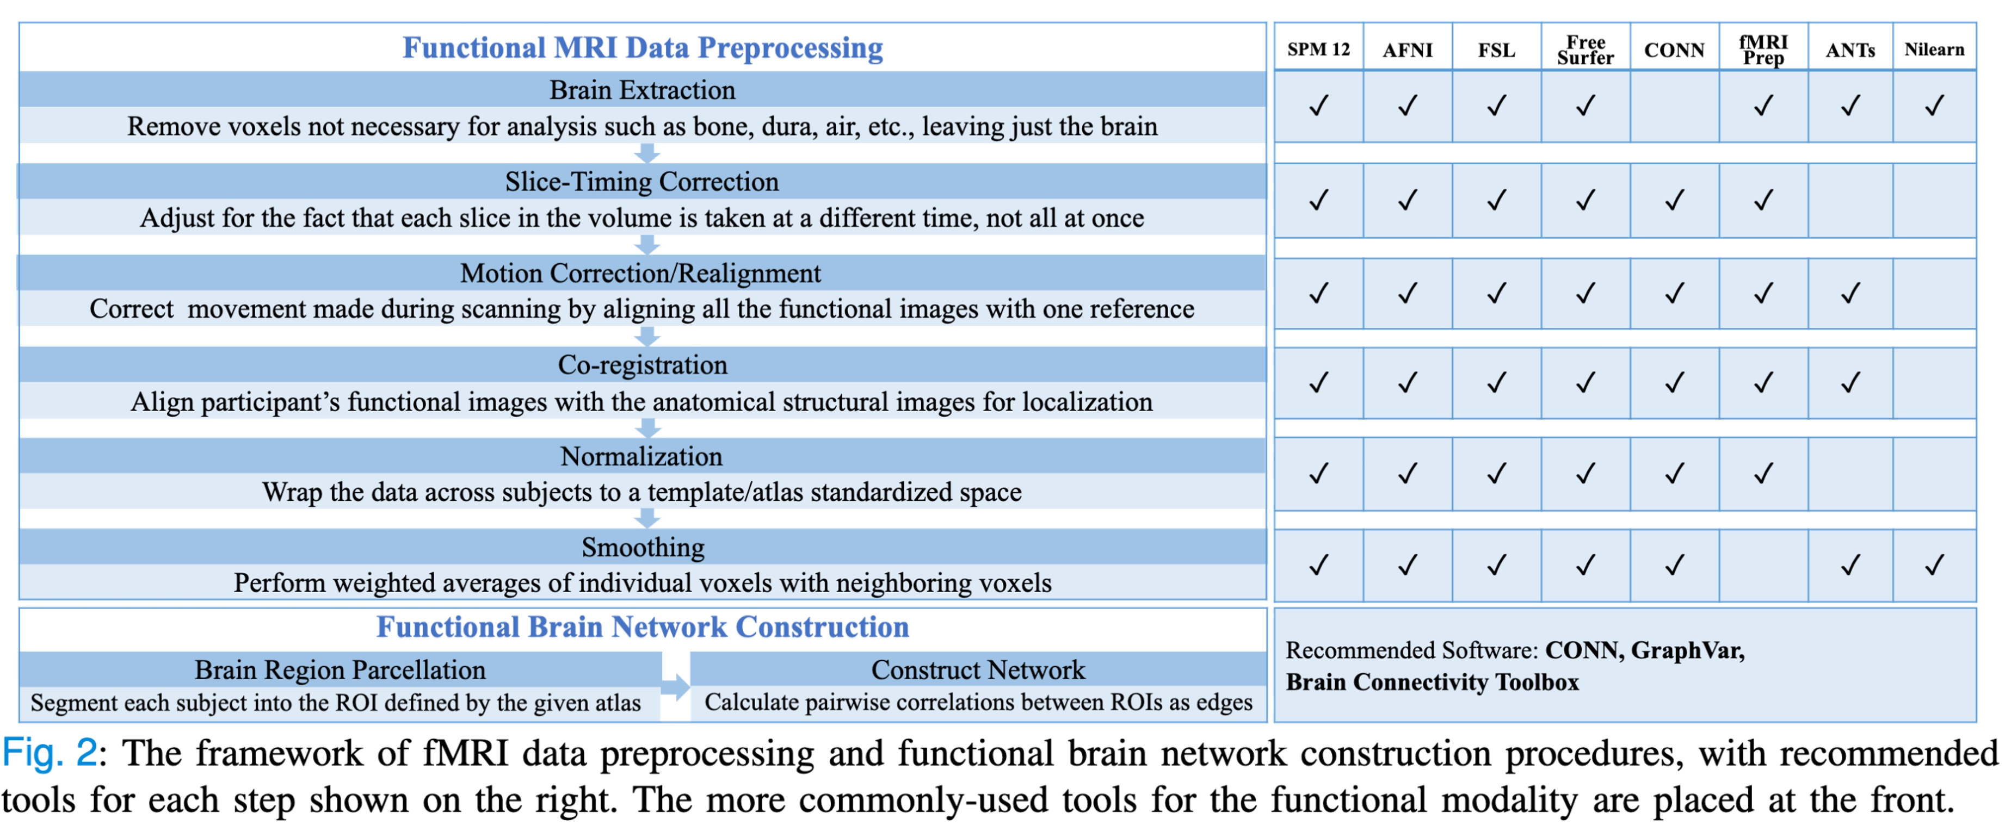
Functional Brain Network Construction
Image Src : BrainGB: A Benchmark for Brain Network Analysis with Graph Neural Networks

Slide 15
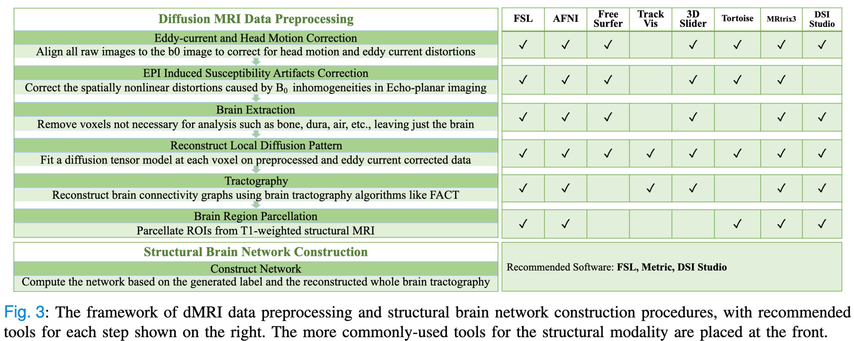
Structural Brain Network Construction
Image Src : BrainGB: A Benchmark for Brain Network Analysis with Graph Neural Networks

Slide 16
Outline
Preliminaries
Brain Network Dataset Construction
GNN Baselines for Brain Network Analysis
Experiments
Discussion and Extensions

Slide 17
GNN Baselines for Brain Network Analysis
Figure1 Recap From Overview
Node features: captures the whole picture of structural information in the brain network and preserves pairwise connections used to perform brain parcellation.
Message passing: node concat reinforces self-representation of the central node during each step of message passing.
Attention-enhanced message passing: the attention mechanism utilizes learnable attention weights in addition to the fixed edge weights in the aggregation and update process of GNNs.
Pooling strategies: in concat pooling, the final node representations of all the brain regions are kept in the graph-level representation for classifiers.
17

Slide 18
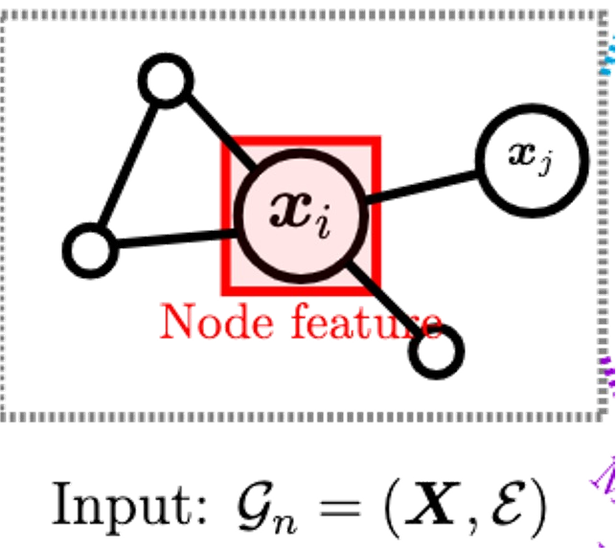
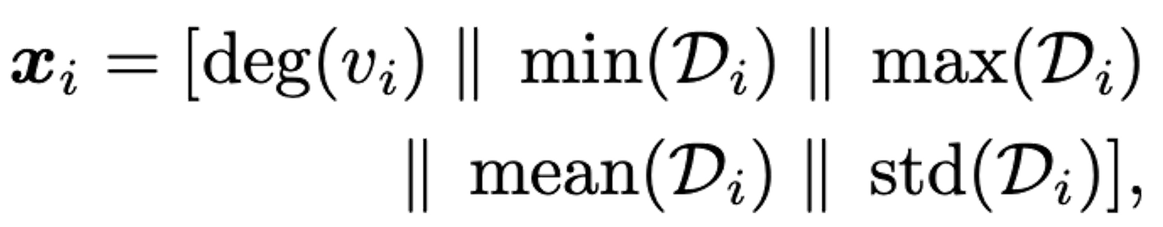
M1: Node Feature Construction
Identity: unique one-hot feature for each node
Eigen: eigen decomposition performed on the weighted matrix, then the top 𝑘 eigenvectors are used to generate a 𝑘 dimensional feature vector for each node.
Degree: degree value as a one-dimensional vector
Degree profile:
Connection profile: the corresponding row for each node in the edge weight matrix
*‖ denotesconcatenation

Slide 19
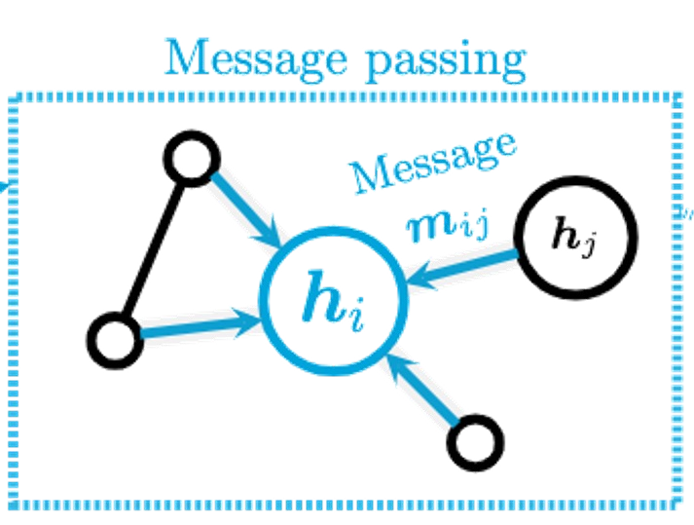
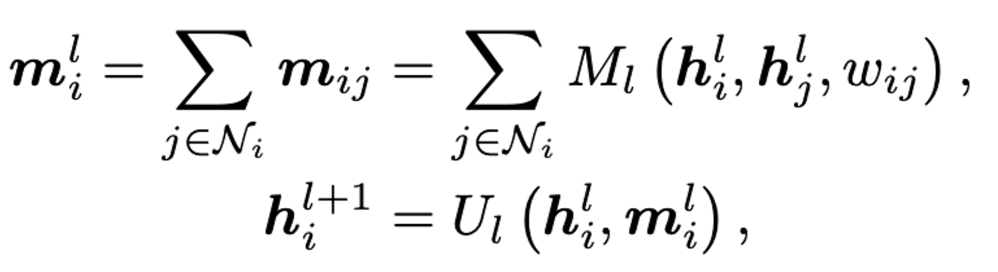
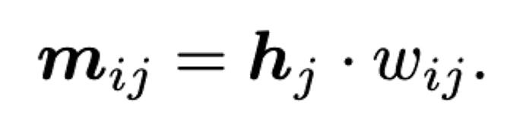
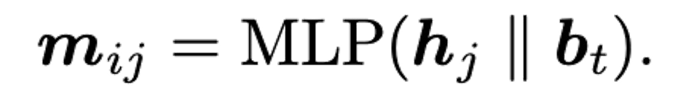
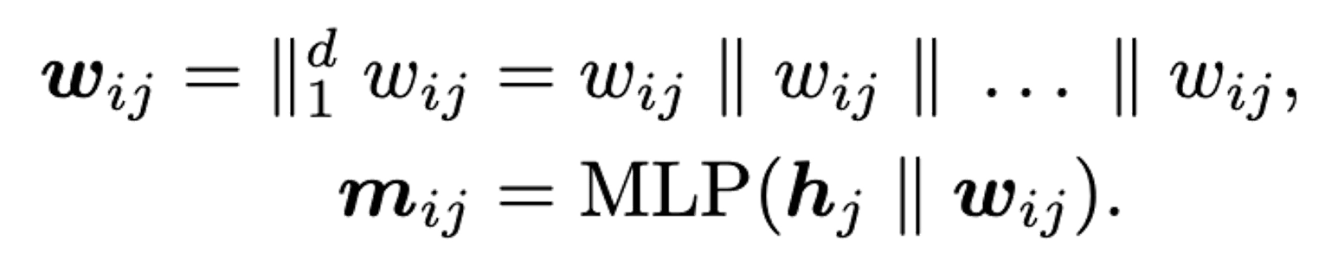
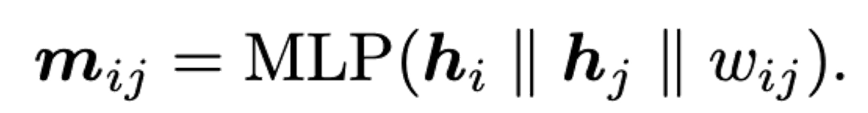
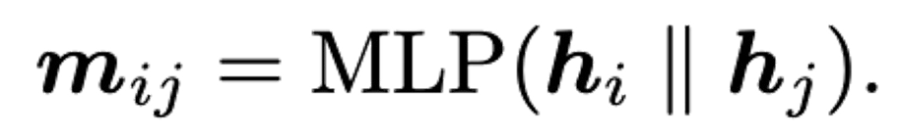
M2: Message Passing Mechanisms
Message passing
Edge weighted:
Bin concat:
Edge weight concat:
Node edge concat:
Node concat:

Slide 20
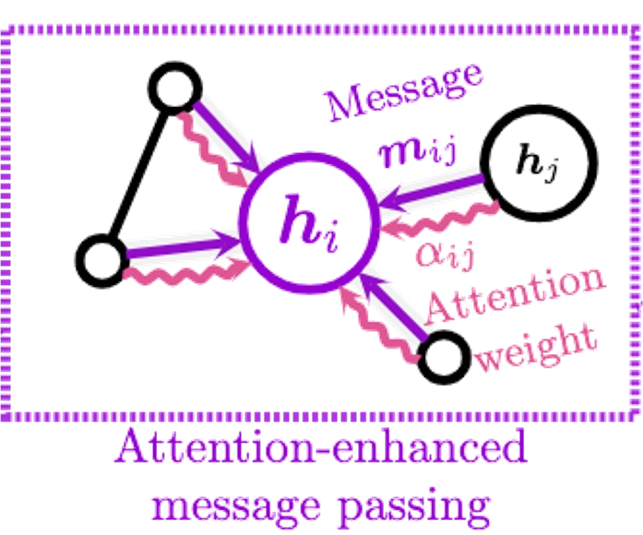
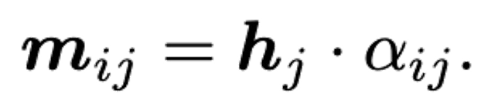
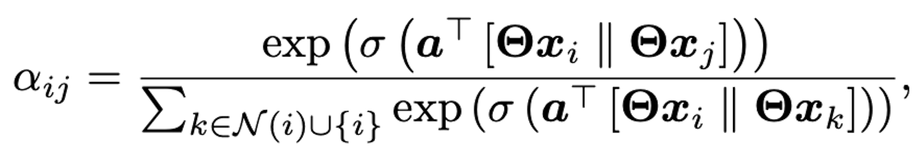
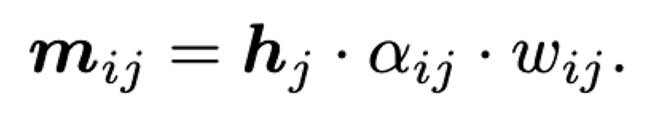
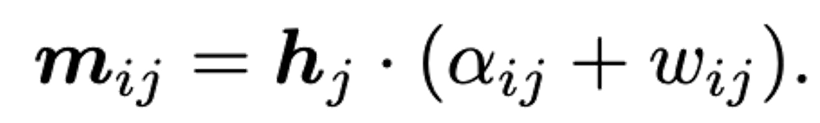
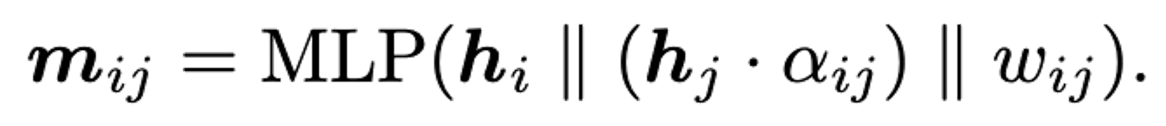
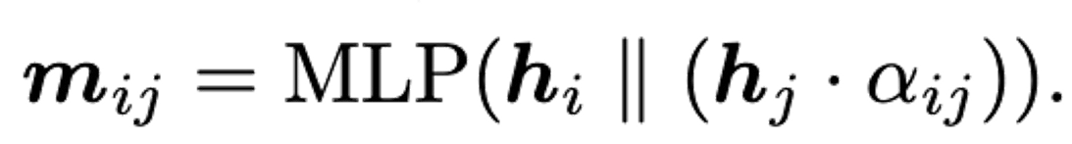
M3: Attention-enhanced Message Passing
Attention weighted:
Edge weighted w/ attn:
Attention edge sum:
Node edge concat w/attn:
Node concat w/attn:

Slide 21
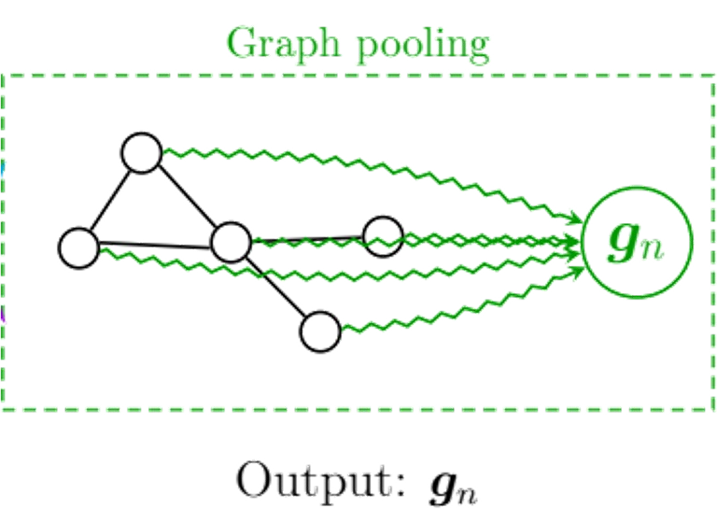
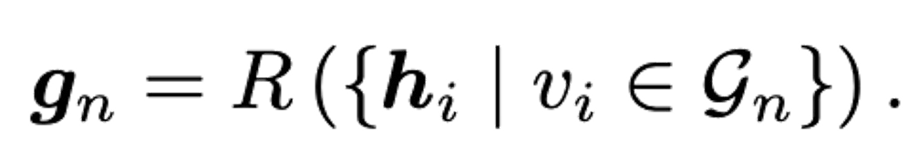
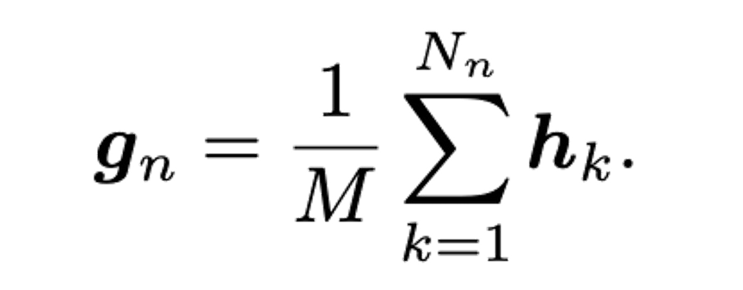
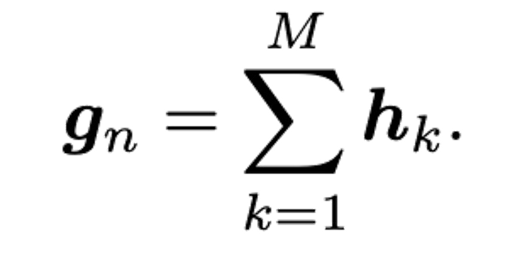
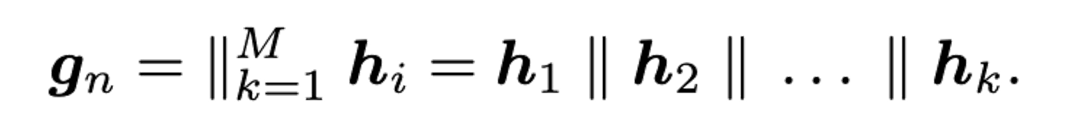
M4: Pooling Strategies
In the second stage of GNNs, a feature vector for the whole graph is computed using the pooling strategy 𝑅,
Mean pooling:
Sum pooling:
Concat pooling:

Slide 22
Outline
Preliminaries
Brain Network Dataset Construction
GNN Baselines for Brain Network Analysis
Experiments
Discussion and Extensions

Slide 23
Datasets
Human Immunodeficiency Virus Infection (HIV)
functional
Philadelphia Neuroimaging Cohort (PNC)
functional
Parkinson’s Progression Markers Initiative (PPMI)
structural
Adolescent Brain Cognitive Development Study (ABCD)
functional

Slide 24
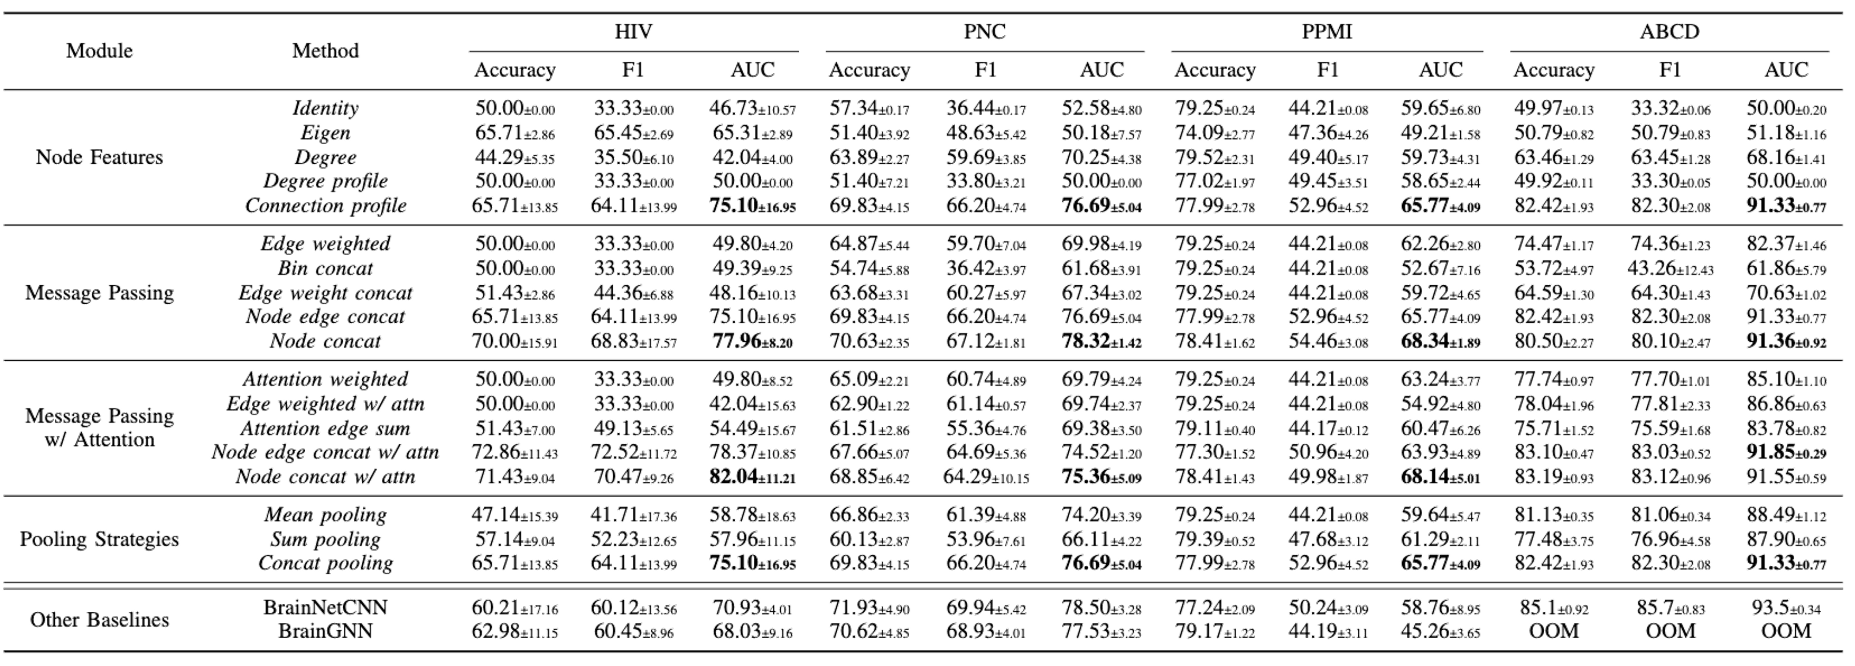
Modular Performance Report
Tab.2. Performance report (%) of different message passing GNNs in the four-modular design space with other two representative baselines on four datasets.
22

Slide 25
Outline
Preliminaries
Brain Network Dataset Construction
GNN Baselines for Brain Network Analysis
Experiments
Discussion and Extensions
25

Slide 26
Contributions of this work
A unified, modular, scalable, and reproducible framework for brain network analysis with GNNs
Summarize the preprocessing and construction pipelines for both functional and structural brain networks
Decompose the design space of GNNs for brain network analysis into four modules:
(a) node features
(b) message passing mechanisms
(c) attention mechanisms
(d) pooling strategies.
Conduct a variety of empirical studies and suggest a set of general recipes for effective GNN designs

Slide 27
Limitations
Graph structure mysteriousness: for brain networks, what kinds of graph structures (e.g., communities, subgraphs) are effective beyond the pairwise connections are still unknown.
Limited Datasets: the small size of neuroimaging datasets may limit the effectiveness and generalization ability of complex deep learning models.

Slide 28
Future Directions
Neurology-driven GNN designs: to design the GNN architectures based on neurological understanding of brain signals, especially disease-specific ones.
Pre-training and transfer learning of GNNs: to design techniques that can train complex GNN models across studies and cohorts. Besides, information sharing across different diseases could lead to a better understanding of cross-disorder commonalities.

Slide 29
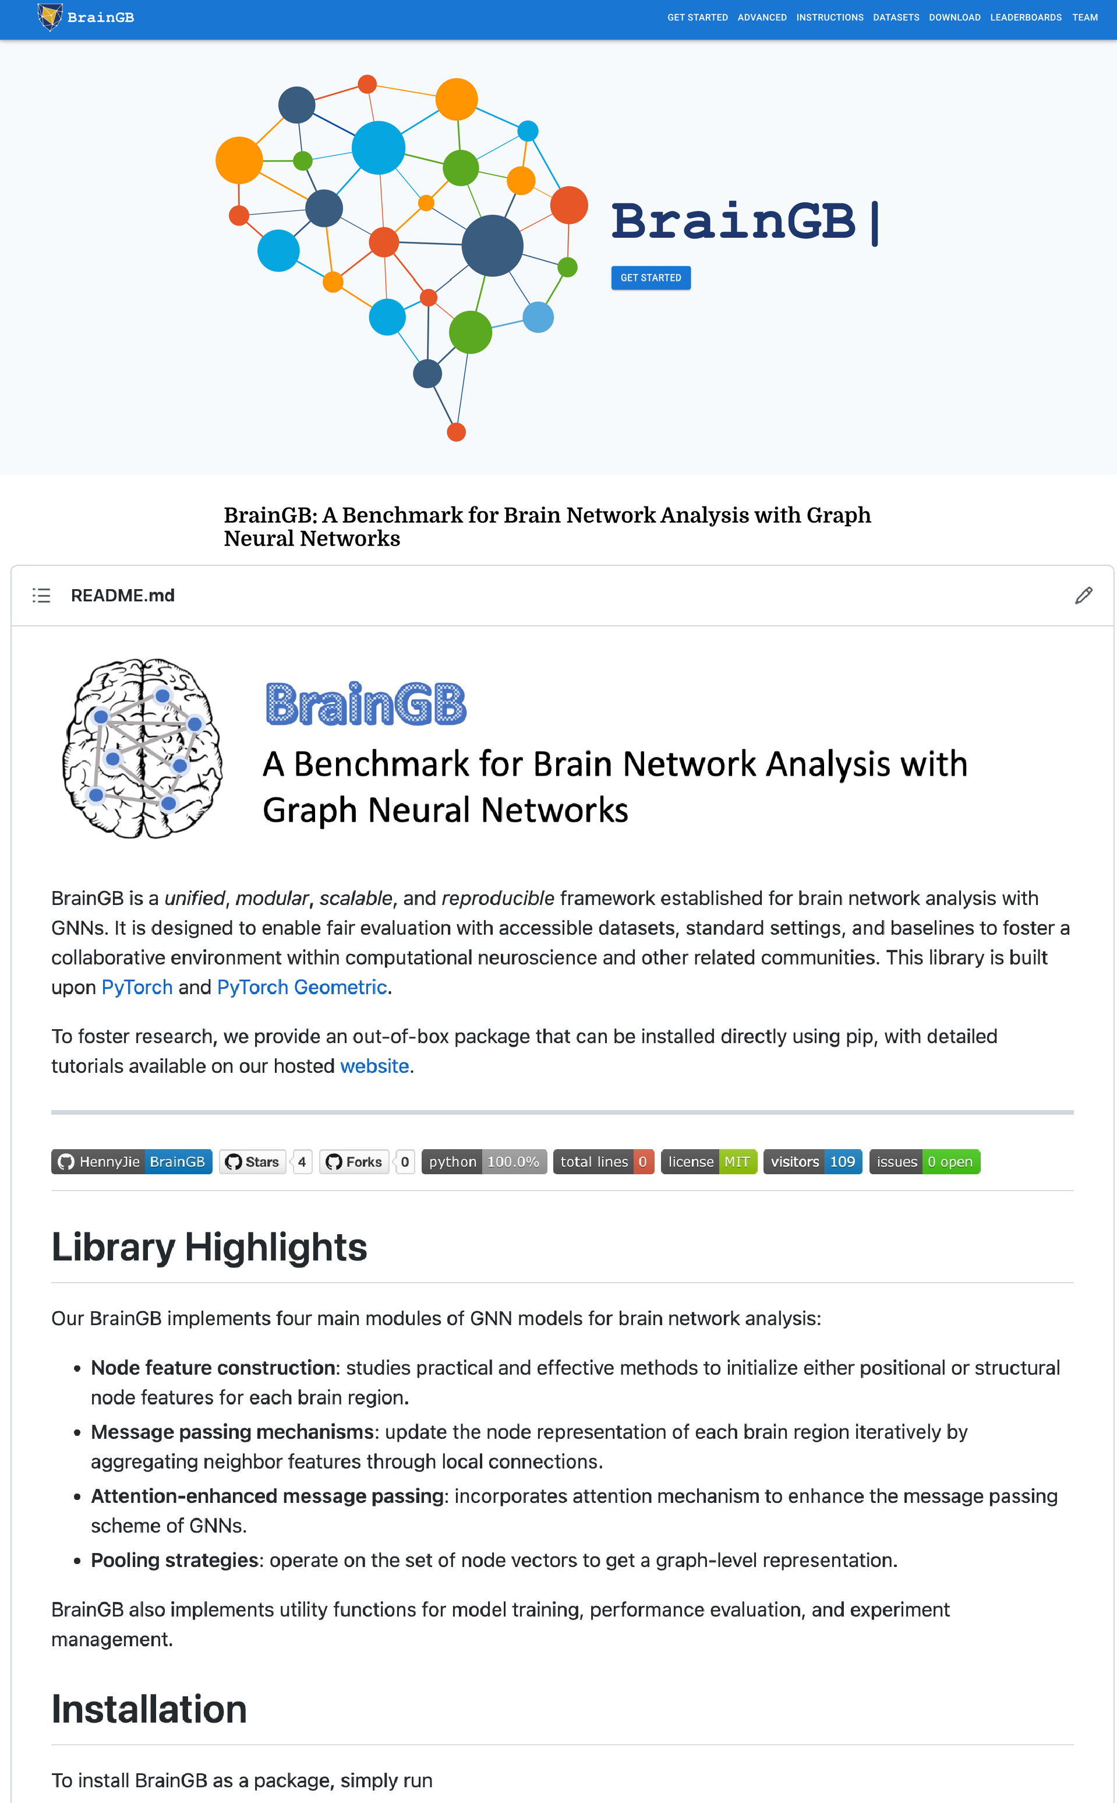
Resources
Website: https://brainnet.us/
tutorials
examples
preprocessing and brain network construction instruction
Out-of-box Python package that can be easily installed by pip
Source code: https://github.com/HennyJie/BrainGB
26

Slide 30

Thank You!
Questions?

